Slide 1
SWE2210 Software Construction: Lesson 3
Bashir S. Galadanci Ph.D.
Buhari Ubale

Slide 2
Contents of Previous Lecture
Is Design Part of Construction
The Different Levels of Design
Characteristics of High Quality Design
The Main Steps in OOP Design
Some Principles of Good Design

Slide 3
Write a Working Class

Slide 4
Programming in Those Days …
In the dawn of computing, programmers thought about programming in terms of statements.
Throughout the 1970s and 1980s, programmers began thinking about programs in terms of routines.
In the twenty-first century, programmers think about programming in terms of classes and objects.
The two most important concepts in object-oriented programming are the class and the object.

Slide 5
Classes, Objects
A class is a collection of data and routines that share a cohesive, well-defined responsibility. A class might also be a collection of routines that provides a cohesive set of services even if no common data is involved.
One of the key aspect to be an effective programmer is to organize a program into modules so that while working on any one section of code, the other sections can be safely ignore. Classes are the primary tool for accomplishing that objective.
A program written in object-oriented style will consist of interacting objects (a thing, both tangible and intangible, that we can imagine).
For example a program to keep track of student residents of a college dormitory, we may have many Student, Room, and Floor objects.

Slide 6
Object Oriented Programming (OOP)
Object Oriented Programming (OOP) involves the following major activities when construction a working class:
designing and constructing classes,
designing the routines inside the classes
developing the routines using the pseudo programming process (PPP)
testing at various levels of the construction of the classes and the development of the routines

Slide 7
Steps in Constructing Classes
Create a general design of the class
Construct the routines within the class
Review and test the class as a whole

Slide 8
Steps in Constructing Classes
Create a general design for the class
Class design step includes numerous specific issues such as:
Define the class’s specific responsibilities
Determine whether the class will be derived from another class and whether other classes will be allowed to derive from it.
Identify the class’s key public methods, and identify and design any nontrivial data members used by the class.
define what “secrets” the class will hide.
define exactly what abstraction the class interface will capture.

Slide 9
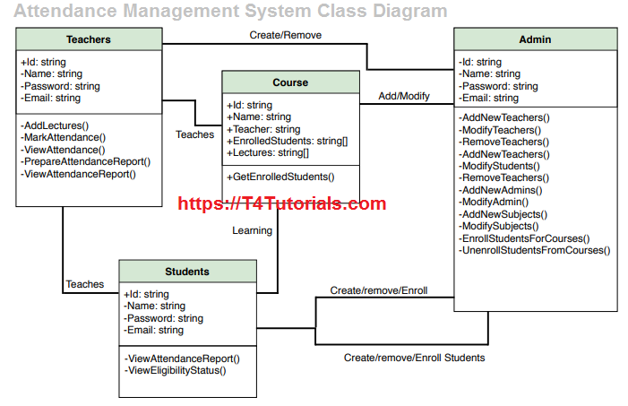
Examples of Classes

Slide 10
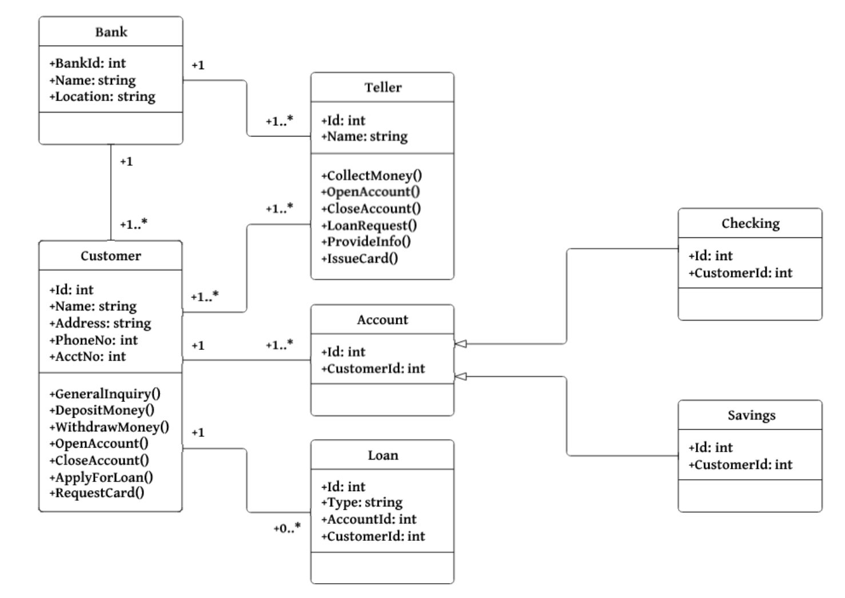
Examples of Classes

Slide 11
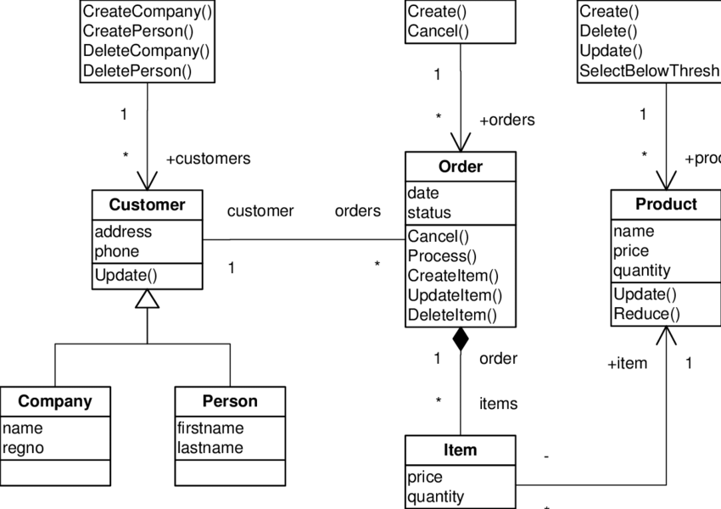
Examples of Classes

Slide 12
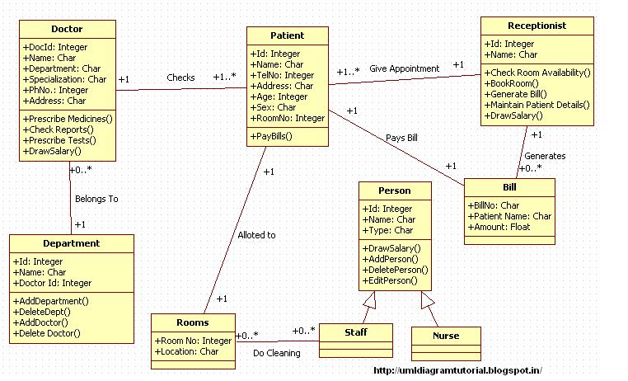
Examples of Classes

Slide 13
Steps in Constructing Classes …
Construct each routine within the class
Once you’ve identified the class’s major routines in the first step, you must construct each specific routine.
Construction of each routine typically unearths the need for additional routines,
Review and test the class as a whole
Normally, each routine is tested as it’s created.
After the class as a whole becomes operational, the class as a whole should be reviewed and tested for any issues that can’t be tested at the individual-routine level.

Slide 14
Constructing Routines
Design the routine
Check the design
Code the routine
Review and test the code

Slide 15
Design and Construction of Routines
Once you’ve identified a class’s routines.
The first step in constructing any of the class’s routines is to design it.
The high-level design should at least indicate the following:
The information the routine will hide
Inputs to the routine
Outputs from the routine
Preconditions that are guaranteed to be true before the routine is called (input values within certain ranges, streams initialized, files opened or closed, buffers filled or flushed, etc.)
Postconditions that the routine guarantees will be true before it passes control back to the caller (output values within specified ranges, streams initialized, files opened or closed, buffers filled or flushed, etc.)

Slide 16
Design and Construction of Routines
Suppose that you want to write a routine ReportErrorMessage() with the following specifications:
“ReportErrorMessage() takes an error code as an input argument and outputs an error message corresponding to the code. It’s responsible for handling invalid codes. If the program is operating interactively, ReportErrorMessage() displays the message to the user. If it’s operating in command-line mode, ReportErrorMessage() logs the message to a message file. After outputting the message, ReportErrorMessage() returns a status value, indicating whether it succeeded or failed.”

Slide 17
Design and Construction of Routines…
Name the routine: A good routine names are one of the sign of a superior program. In general, a routine should have a clear and unambiguous name. A good routine name should usually indicates the purpose of the routine clearly. E.g. ReportErrorMessage()
Decide how to test the routine: As you’re writing the routine, think about how you can test it. This is useful for you when you do unit testing and for the tester who tests your routine independently. Here you might plan to test with all valid and a variety of invalid input.

Slide 18
Design and Construction of Routines…
Research functionality available in the standard libraries: One of the biggest way to improve both the quality of your code and your productivity is to reuse good code.
If you find yourself grappling to design a routine that seems to be complicated, ask whether some or all of the routine’s functionalities might already be available in the library code of the language or tools you’re using or is available in library code maintained by your company.
Many algorithms have already been invented, tested, discussed in the trade literature, reviewed, and improved.
Think about error handling Think about all the things that could possibly go wrong in the routine. Think about bad input values, invalid values returned from other routines, and so on. Routines can handle errors in numerous ways, and you should choose the appropriate way on how to handle errors. If the program’s architecture defines the strategy for handling program’s error, you can simply plan to follow that strategy.
In other cases, you have to decide what approach will work best for the specific routine.

Slide 19
Design and Construction of Routines…
Research the algorithms and data types: If functionality isn’t available in the libraries code of the language, so it might still be described in an algorithms books.
Before you launch into writing complicated code from scratch, check an algorithms books to see what’s already available. If you use a predefined algorithm, be sure to adapt it correctly to your programming language.
Write the pseudocode: You might not have much in writing after you finish the preceding steps. The main purpose of the steps is to establish a mental orientation that’s useful when you actually write the routine.

Slide 20
Writing Pseudo Code
With the preliminary steps completed, you can begin to write the routine as high-level pseudo code.
Start with the general and work toward something more specific. The most general part of a routine is a header comment describing what the routine is supposed to do, so
first write a concise statement of the purpose of the routine.
Writing the statement will help you clarify your understanding of the routine.

Slide 21
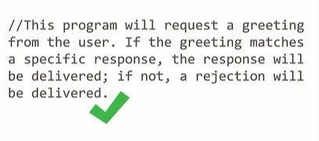
Example of comment header

Slide 22
Writing Pseudo Code …
Use English-like statements that precisely describe specific operations.
Avoid syntactic elements from the target programming language. Pseudocode allows you to design at a slightly higher level than the code itself.
When you use programming-language constructs, you sink to a lower level, eliminating the main benefit of design at a higher level, and you saddle yourself with unnecessary syntactic restrictions.
Describe the meaning of the approach rather than how the approach will be implemented in the target language.
Write pseudo code at a low enough level that generating code from it will be nearly automatic.
Refine the pseudo code in more and more detail until it seems as if it would be easier to simply write the code.

Slide 23
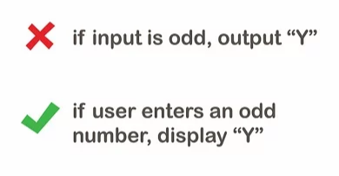
Writing Pseudo Code …

Slide 24
Writing Pseudo Code …
Check the pseudocode: Once you’ve written the pseudocode and designed the data, take a minute to review the pseudocode you’ve written.
Think about how you would explain it to someone else.
Ask someone else to look at it or listen to you explaining it.

Slide 25
Writing Pseudo Code …

Slide 26
Writing Pseudo Code …
Write the routine declaration: Write the routine interface statement—the function declaration in C++, method declaration in Java, function or sub procedure declaration in Microsoft Visual Basic, or whatever your language calls for.
Turn the original header comment into a programming-language comment. Leave it in position above the pseudocode you’ve already written.
Fill in the code below each comment: Fill in the code below each line of pseudocode comment. Each pseudocode comment describes a block or paragraph of code.

Slide 27
Writing Pseudo Code …
Check the Code
After designing and implementing the routine, the third big step in constructing it is checking to be sure that what you’ve constructed is correct. Any errors you miss at this stage won’t be found until later testing. They’re more expensive to find and correct then, so you should find all that you can at this stage.
Mentally check the routine for errors
The first formal check of a routine is mental. The clean-up and informal checking steps mentioned earlier are two kinds of mental checks. Another is executing each path mentally. Mentally executing a routine is difficult, and that difficulty is one reason to keep your routines small. Make sure that you check nominal paths and endpoints and all exception conditions.

Slide 28
Writing Pseudo Code …
Compile the routine
After reviewing the routine, compile it.
Step through the code in the debugger
Once the routine compiles, put it into the debugger and step through each line of code. Make sure each line executes as you expect it to. You can find many errors by following this simple practice.
Test the code
Test the code using the test cases you planned or created while you were developing the routine. You might have to develop scaffolding to support your test cases—that is, code that’s used to support routines while they’re tested and that isn’t included in the final product.

Slide 29
Writing Pseudo Code …
Remove errors from the routine
Once an error has been detected, it has to be removed. If the routine you’re developing is buggy at this point, chances are good that it will stay buggy. If you find that a routine is unusually buggy, start over.
Take Clean-up Steps
When you’ve finished checking your code for problems, take some clean-up steps to make sure that the routine’s quality is up to the desired standards:
Check the routine’s interface. Make sure that all input and output data is accounted for and that all parameters are used.
Check for general design quality. Make sure the routine does one thing and does it well, that it’s loosely coupled to other routines, and that it’s designed defensively.
Check the routine’s variables. Check for inaccurate variable names, unused objects, undeclared variables, improperly initialized objects, and so on.

Slide 30
Writing Pseudo Code …

Slide 31
Writing Pseudo Code …

Slide 32
Key Points
Constructing classes and constructing routines tends to be an iterative process. Insights gained while constructing specific routines tend to ripple back through the class’s design.
Writing good pseudocode calls for using understandable English, avoiding features specific to a single programming language, and writing at the level of intent (describing what the design does rather than how it will do it).
The Pseudocode Programming Process is a useful tool for detailed design and makes coding easy. Pseudocode translates directly into comments, ensuring that the comments are accurate and useful.
Don’t settle for the first design you think of. Iterate through multiple approaches in pseudocode and pick the best approach before you begin writing code.
Check your work at each step, and encourage others to check it too. That way, you’ll catch mistakes at the least expensive level, when you’ve invested the least amount of effort.

Slide 33
Thank You

